Slide 1
Cybersecurity at PJM
Jonathon Monken
Senior Director, System Resilience and Strategic Coordination

Slide 2
Threat Environment
Nation state threats
Un-attributable threat actors
Insider threats
Additional man-made or natural events
Notes:
Threats to PJM’s overall security and resilience are always developing.
Using threat intelligence and analysis, PJM continuously evaluates potential attacks, including:
Threats from nation-states, due to their increased capability and intent to perform cyberattacks Examples: North Korea, Iran, China and Russia
Potential threats from people inside PJM – a complex and dynamic attack vector
Threats from actors that cannot be specifically identified (cyber criminal or “hacktavist” organizations)
High impact but low frequency events including severe weather events, geomagnetic disturbances, electromagnetic pulses and terrorism

Slide 3
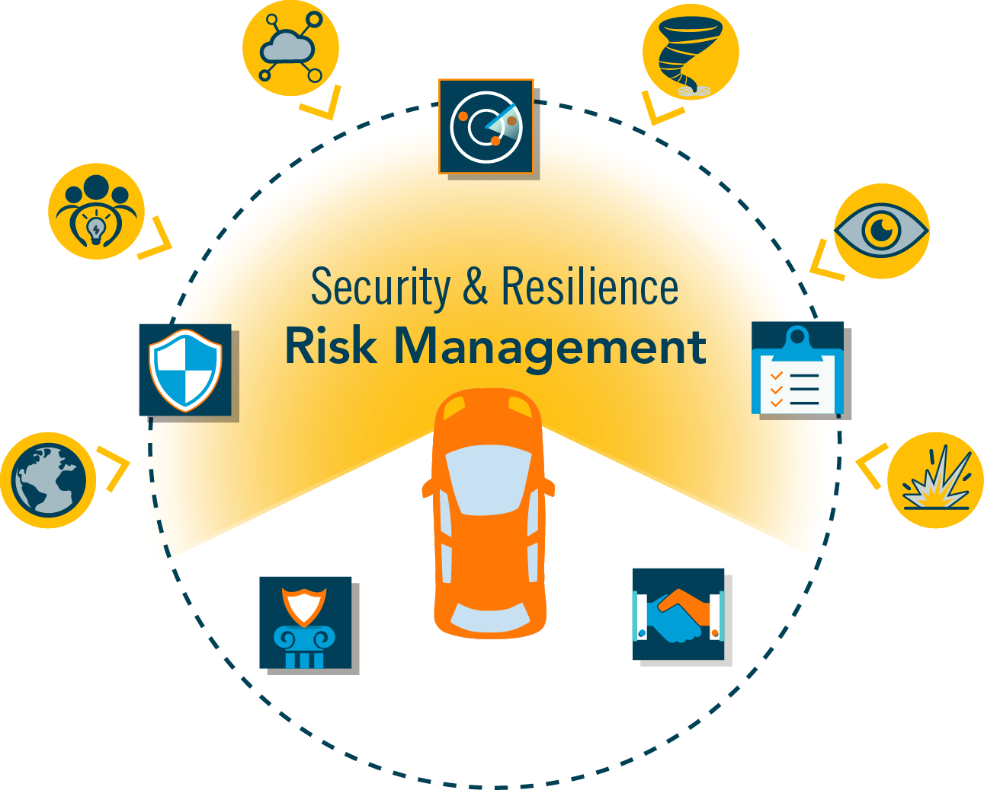
PJM’s Five Strategic Objectives to Manage Threats
Risk Management
Defense
Response
Education
Partnership
Notes:
PJM’s security and resilience program consists of five strategic objectives that work to improve resilience in the face of a wide spectrum of threats and hazards.
Risk Management: Driving investment and resources to the highest risk areas of PJM’s security and resilience program.
Defense: Fortifying systems, information, and facilities by slowing down and stopping threats.
Response: Enabling early detection of and responding effectively to attacks to minimize operational impacts and to speed recovery of systems.
Education: Training the PJM workforce and a team of highly competent security professionals to spot threats, report anomalies and drive vigilance.
Partnership: Collaborating and leveraging the capabilities and expertise of key partners across government, industry and other critical infrastructures.
These objectives also allow for feedback that helps PJM continuously improve its security posture.

Slide 4
Defense
Information Sharing
Data Management
Vulnerability Management
Defense
Predictive Analytics
Impact Analysis
Technology Lifecycle
Notes:
PJM’s defense strategy includes:
Information Sharing – sharing best practices and known threats to avoid vulnerabilities internally and with the appropriate external partners
Vulnerability Management – is integral to cybersecurity and is the practice of identifying, classifying, remediating or mitigating vulnerabilities
Impact Analysis – knowing the impacts that can be created by change or disruption downstream. It helps to forecast consequences of business function disruptions and a step to develop incident or disaster recovery strategies.
Technology Lifecycle Management – practice of managing technology from initial use to retirement
Predictive Analytics – uses data mining to extract information from data and uses it to predict trends and behavior patterns
Data Management – ensuring CIP information remains confidential and restricting access for both physical and cyber to make sure the right people have the right access to the right assets

Slide 5
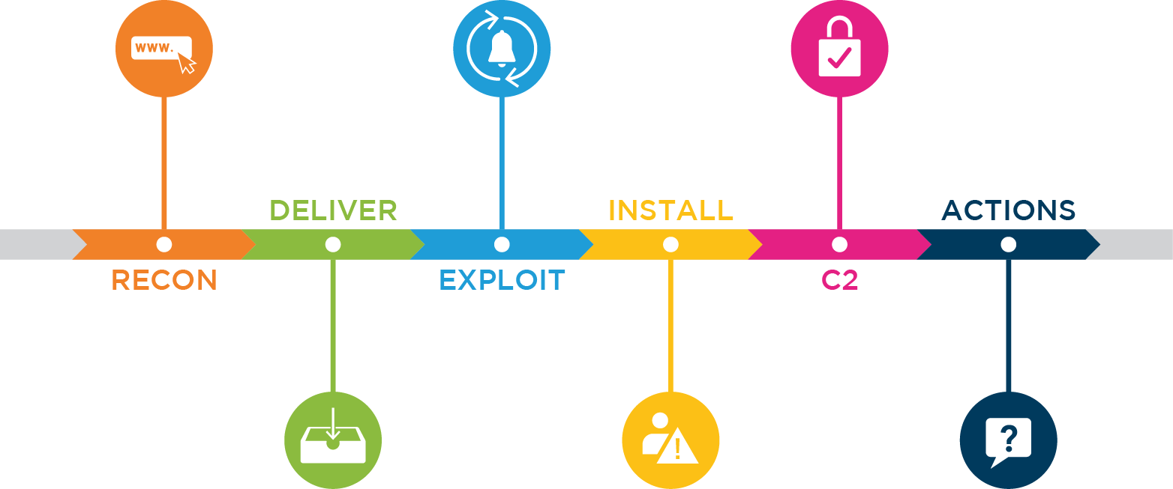
Phases of the Cyber Kill Chain®
The delivery of a weaponized package. This may be via a phishing email, a compromised website (watering hole attack), or a USB stick.
Installing an attack toolkit on the exploited system in order to gain persistent access to the system.
Completing the original mission of the attack. Includes data exfiltration, denial of service and sabotage.
Reconnaissance activity to discover characteristics of PJM systems and personnel with a goal of weaponizing malware or a customized cyberattack.
Running the weaponized package to take temporary control of a computer system by taking advantage of a vulnerability.
Connecting to a command and control server to pick up instructions or additional attack tools.
Cyber Kill Chain is a registered trademark of Lockheed-Martin (Weaponization phase excluded).

Slide 6
Response
Government Sources
Situational Awareness
Response Coordination
Industry Sources
Commercial Sources
Notes:
PJM relies on intelligence from government, industry partners, commercial sources, and our own security events.
This intelligence is a vital part of our cyber and physical monitoring processes and tools, and enhances our abilities to respond to events.
Sources:
Government sources: Congressional Research Institute for Social Work & Policy, Federal Bureau of Investigation, National Cybersecurity & Communications Integration Center
Industry sources: AEP’s Cyber Security Operations Center, Electricity Information Sharing and Analysis Center (E-ISAC), Electricity Subsector Coordinating Council (ESCC)
Situational awareness: PJM security events (what are they? Should this be included?), PJM as a regional coordinator, public/private partnership
Commercial sources: Patch management updates, Technology vendors, interdependent infrastructure industry—coordinating with natural gas industry, communications, etc.

Slide 7
Education
Training and Exercise Activities
Corporate-wide Training
Comprehensive Exercises GridEx and EarthEx
NERC CIP Training and Assessment
Cybersecurity Education Professional Certifications Certificate Programs Advanced Degrees
Proposed PJM Security and Resilience Committee
Notes:
PJM educates our employees to ensure our ability to react to events.
This includes PJM’s participation in GridEx, which is a North American-wide simulation of a coordinated cyber and physical attack against multiple asset owners.
PJM has consistently participated as a full participant, and for GridEx III, PJM is helping to lead the development of the scenario and coordination between Reliability Coordinators and asset owners.
PJM is regularly assessed by the North American Electric Reliability Corporation to ensure we meet or exceed critical information protection standards.
PJM encourages its staff tasked with protecting its critical information and infrastructure to pursue continuing education opportunities, including through professional certifications and advanced degrees.
PJM has proposed a Security and Resilience Committee that is designed to take a proactive approach to discussing a broad range of security- and resilience-related topics with PJM stakeholders. It will replace the current Security and Resilience Subcommittee.

Slide 8
Cybersecurity Partnerships

Slide 9
Where is this road taking us?
Machine-speed information sharing
Larger attacks surface area
IoT Devices
Distributed Energy Resources
Evolving threat actors

